Slide 1


HR Analytics Dashboard: An End-to-End Workforce Analysis
A Multi-Platform Pipeline for Headcount, Turnover, and Retention Metrics Using SQL, Excel, Power BI, and Tableau
PRESENTED BY
Group 1

Slide 2
Objective of the Project
Evaluate a workforce dataset of 50,000 enterprise records to uncover key trends behind employee attrition, headcount distribution, and compensation structures.
Implement a synchronized data workflow across four major industry tools: SQL (validation), Excel (ingestion), Power BI (modeling), and Tableau (trend analysis).
Baseline core HR metrics including Total Headcount, Attrition Counts, and Attrition Rates with extreme tool-to-tool mathematical alignment.
Identify organizational retention risks by cross-filtering key socio-demographic indicators such as Department, Gender, Income, and Travel Frequency.
Deliver interactive, user-friendly business dashboards that transform raw complex data tables into actionable, real-time insights for HR leadership.

Slide 3
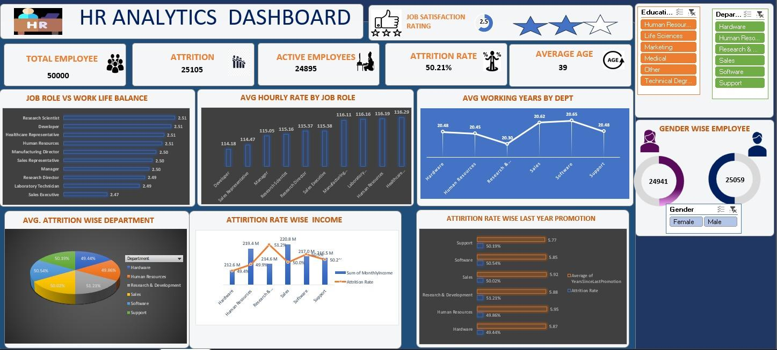

Excel Analytical Prototype
Cleaning the Raw Data: We used Excel as our first step to look through all 50,000 employee records. It helped us quickly find mistakes, remove duplicate information, and make sure the data was clean before moving it to other tools.
Double-Checking the Numbers: Excel allowed us to quickly calculate our starting numbers—like the 50.21% attrition rate and the average age of 39. This gave us a solid baseline we knew we could trust.
Grouping Big Numbers: We used Excel to group complicated numbers into simple categories. For example, instead of looking at thousands of different salaries, we grouped them into clear brackets (like $21k–$31k and $41k–$51k) to see exactly where people were leaving.
Building the First Prototype: The Excel dashboard (shown in the image) served as our first rough draft. It allowed us to map out our charts and decide on the visual story before building the final dashboards in Power BI and Tableau.

Slide 4
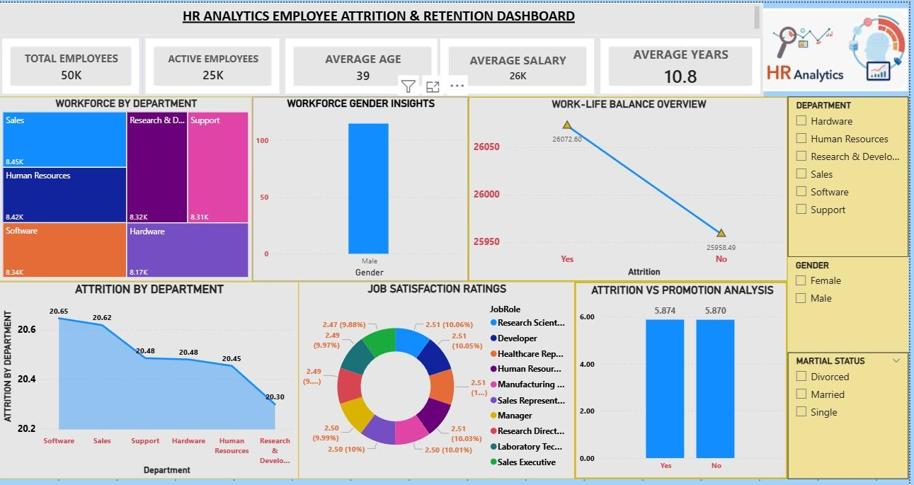
Power BI Relational Modeling
Creating Smart Relationships: While Excel is great for flat tables, Power BI allowed us to link different sets of data together (like job roles, departments, and salaries). This created a "relational model" that lets us see how different parts of the business affect one another.
Complex Data Modeling: We used Power BI to create custom "Calculated Columns" and "Measures." This allowed us to build advanced metrics—like finding specific attrition patterns within departments—that standard spreadsheets just couldn't handle.
Interactive Slicers & Filters: We added interactive tools (slicers) that let users click on a specific department or gender to see the data change instantly. This turned a massive 50,000-record dataset into an easy-to-explore experience.
Deep-Dive Analysis: Power BI helped us go beyond simple counting. We used it to look for hidden trends, such as which job roles were struggling the most with work-life balance, by visualizing the data in ways that made patterns immediately obvious.

Slide 5
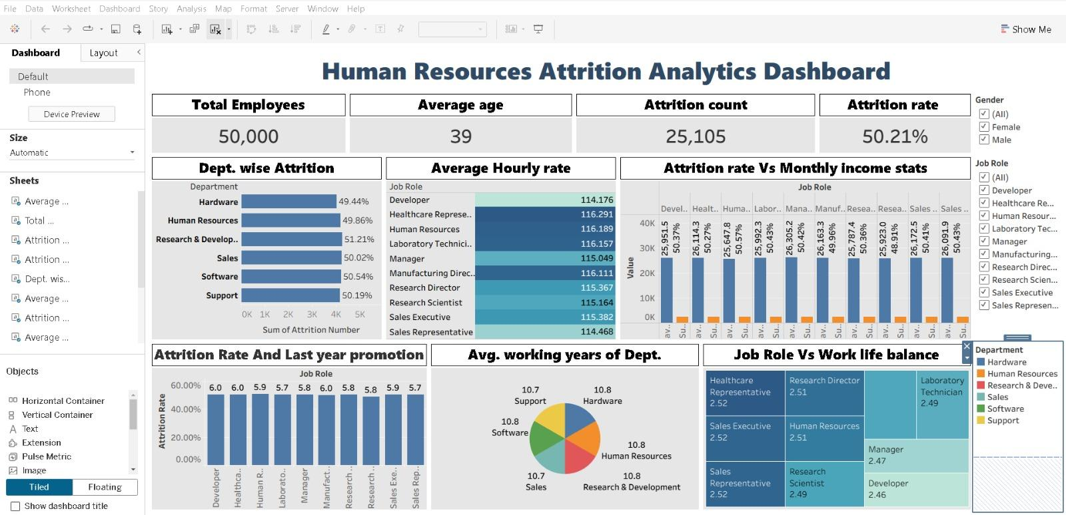
Tableau Dynamic Visualization
Advanced Visuals: Tableau allowed us to build clean, high-resolution charts like Tree Maps and multi-metric Bar Charts that make complex data easy to understand at a glance.
Interactive Filters: We included easy-to-use drop-down menus for Gender, Job Role, and Department so users can filter the entire dashboard with one click.
Clear KPI Tracking: It helped us display our main high-level numbers—like Total Employees (50,000) and Attrition Rate (50.21%)—boldly at the very top for stakeholders.
Executive-Ready Reporting: It provided a highly professional, interactive interface designed specifically to help leadership make quick, data-driven decisions.

Slide 6
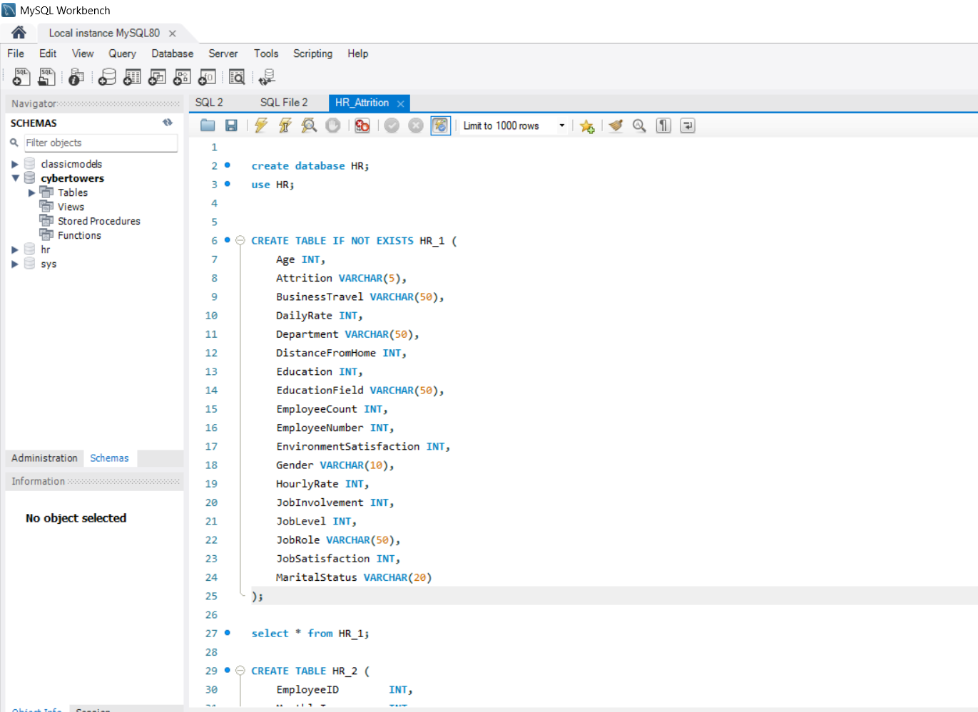
SQL Backend Schema Validation
Verifying the Data: Used SQL code to make sure all 50,000 employee records were loaded correctly without any missing pieces or duplicates.
Double-Checking Calculations: Ran separate background checks to prove that our 50.21% turnover rate was perfectly accurate across all tools.
Handling Big Datasets: Allowed us to quickly search, filter, and group massive amounts of information without slowing down our computers.

Slide 7







Workforce Metrics & Narrative
EXECUTIVE INSIGHTS
The Story Told by the Numbers
Our multi-platform analysis across all analytical tools centered on establishing a single source of truth. Looking at these 7 critical baseline metrics, we uncover a profound narrative of our workforce dynamics:
TOTAL EMPLOYEE DATASET
50,000 Records
A Staggering Retention Challenge: Over half of our historic 50k employee pool, specifically 25,105 exits (50.21% Attrition), has departed, exposing structural issues requiring vital strategic adjustments.
EXITED (ATTRITION)
ACTIVE STAFF
ATTRITION RATE
25,105
24,895
50.21%
Deep Loss of Experienced Talent: With an Average Age of 39 and a strong Average Tenure of 10.8 Years, the exits are heavily impacting seasoned veterans and institutional memory.
AVERAGE AGE
AVERAGE SALARY
AVG TENURE
39 Years
$26,000
10.8 Years
High Cost-to-Business Exposure: Managing an average payroll exposure of $26k per departed head multiplies recruiting, training, and lost-productivity costs exponentially.

Slide 8





Key Insights from the Data
Critical Macro Turnover Benchmark
Across the organization's comprehensive 50,000-employee data profile, the baseline Attrition Rate stands at a severe 50.21% (representing 25,105 departed individuals), signaling an urgent need for structural retention strategies.
High-Risk Business Segments
The Income Threshold Threat
Departmental isolation shows that Research & Development experiences the highest attrition at 51.21%, closely trailed by Software at 50.54%, indicating that critical technical and innovation hubs are facing the highest flight risk.
Turnover spikes significantly to its highest peak of 50.89% to 51.26% within the highest monthly income bracket ($41,000–$51,000+), debunking the assumption that turnover is strictly limited to lower-paid roles.
Late-Career Tenured Burnout Horizon
Universal Quality of Life Floor
The average tenure across departments is heavily concentrated between 20.30 and 20.65 total working years, demonstrating that departures are severely impacting highly integrated workforce brackets rather than onboarding cohorts.
The organizational Average Work-Life Balance score is locked at a mediocre 2.50 out of 4.00, showing a system-wide cultural ceiling that actively contributes to sustained workforce exhaustion.

Slide 9




Observations from the Data
Promotion Stagnation Catalyst
Institutional Knowledge Drain
Attrition stays steady at ~50% for years, but spikes drastically to 56.28%, 60.53%, and a peak of 77.78% between 20 to 36 years post-promotion, linking long-term stagnation directly to exits.
Because the average working years prior to attrition cluster around 20.5 years (led by Software at 20.65 and Sales at 20.62), departing personnel actively drain decades of legacy operational intelligence.
Analytical Lineage
End-to-end data validation across Excel, Power BI, and Tableau yields a perfect metric match:
Leadership Succession Deficit
Role-Specific Cultural Variation
With an organization-wide Average Age of 39, losing employees who possess over 20 years of experience severely shrinks the internal talent pool, creating an immediate gap for future senior leadership roles.
While roles like Sales Executive score the lowest in Work-Life Balance at 2.47, technical roles like Research Scientists and Developers hover slightly higher at 2.51, requiring targeted cultural initiatives.
This cross-platform match confirms absolute pipeline accuracy, data processing security, and complete model reliability.

Slide 10


Suggestions Based on the Data
Targeted "Tenure-Risk" Check-ins: Trigger stay interviews 30–60 days before critical milestones where turnover pressure builds (specifically targeting 15–20 year working thresholds).
DATA-DRIVEN INTERVENTIONS
Stagnation Breakout Framework: Address promotion-related attrition spikes (up to 77.78%) by introducing horizontal career path rotations for personnel exceeding a 15-year promotion freeze.
Transforming Data into Retention Plans
By translating critical turnover drivers into focused retention frameworks, leadership can actively target high-risk attrition and safeguard our core talent pool.
Deploy Executive Retention Packages: Counter the 50.89%–51.26% high-earner turnover with non-monetary incentives like equity, long-term care sabbaticals, and enhanced autonomy.
Localized Work-Life Interventions: Support low Work-Life scoring roles—specifically Sales Executives (2.47) and Lab Technicians (2.49)—with mandatory rest cycles and hybrid structures.
5
High-Impact Actionable Suggestions for the Company
Mitigate Technical Hub Churn: Resolve the peak 51.21% R&D attrition rate by introducing specialized project bonuses, innovation grants, and technical path advancements.

Slide 11




Conclusion of the Project
End-to-End Analytics Competency
Evolved Business Intelligence Architecture
Successfully executed a full-stack analyst pipeline: verifying data integrity, designing robust schemas in SQL and Excel, and publishing dynamic business intelligence dashboards in Power BI and Tableau.
Converted a massive, disjointed dataset of 50,000 workforce records into an integrated enterprise-grade reporting ecosystem, empowering stakeholders to drill down past superficial high-level averages.
Empirical Strategic Clarity
Measurable Corporate Optimization Impact
Isolated the severe 50.21% macro attrition rate and systematically mapped it to chronic career promotion freezes (climbing to 77.78% risk) and high-earner compensation boundaries to define target retention rules.
Transitioning from static, descriptive lists to proactive multi-tool analytical forecasting equips executive decision-makers with the infrastructure to curb recruit onboarding costs and protect veteran legacy assets.

Slide 12

Thank You!
TEAM
Group 1

